Slide 1
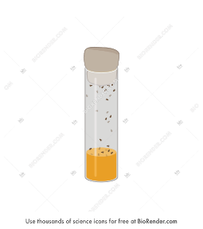
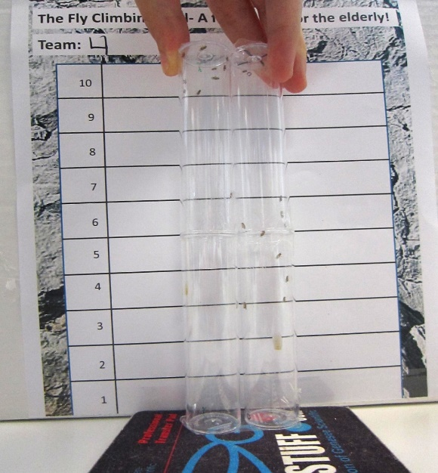
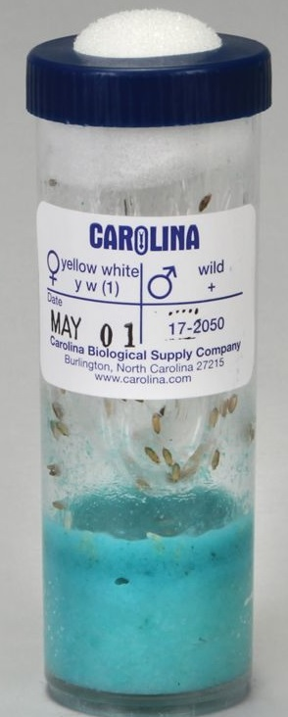
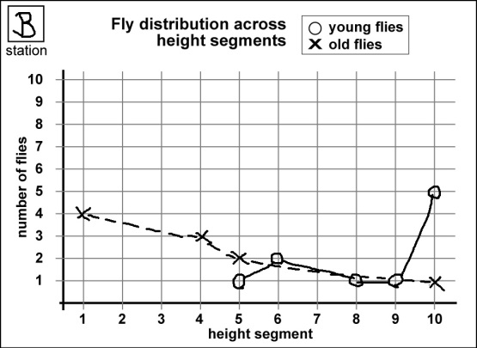
Transfer 10 to each vial with contaminated food
Run assay with repeats and photographs
Transfer to
Empty vials
Flies from Carolina Biological
Tabulate data
Make
graphs
Images from: Carolina Biological,
Droso4schools and Biorender

