Slide 1




“Promoting scientific communication and intergenerational learning in a K-12 drinking water project (Communicating Data)”
Jane E. Disney, Ph.D.
NIH Science Education Partnership Award (SEPA)
New Teacher Introduction-NH Datacom Workshop Oct. 23 and 24, 2025
The National Institute of Nursing Research of the National Institutes of Health supports our new SEPA project under Award Number 1R25NR021077.

Slide 2
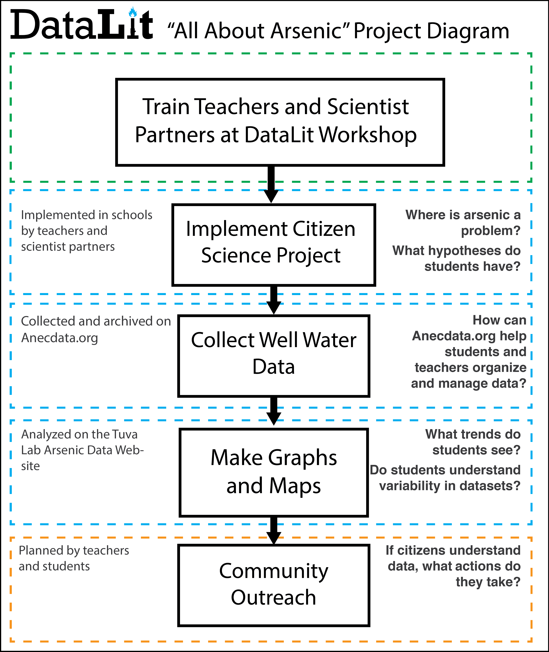



Our SEPA Toolkit
We have three intersecting websites supporting our project
Partners
Collect Drinking Water Data
For data management and sharing
To build student data literacy skills
All About Arsenic+
Notes:
All About Arsenic provides resources and curriculum; “gateway” into the project
Anecdata is the data collection and management and sample registration portal
Tuva provides data literacy tools and we have our own arsenic data page

Slide 3
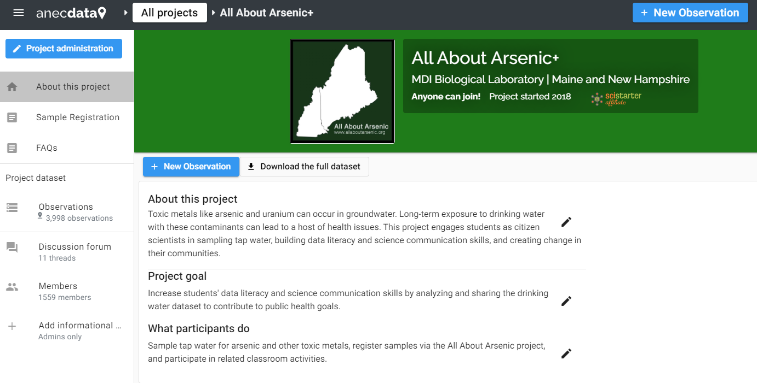

Slide 4
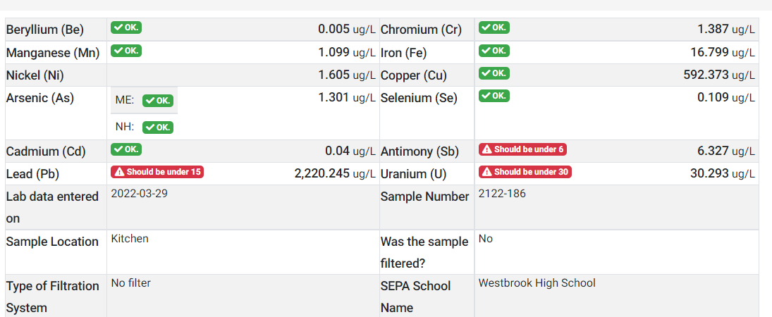
Data Management in Anecdata
Notes:
Exceedances of Maximum Contaminant Levels are highlighted in red so that the well owner can easily see where the problems are.

Slide 5
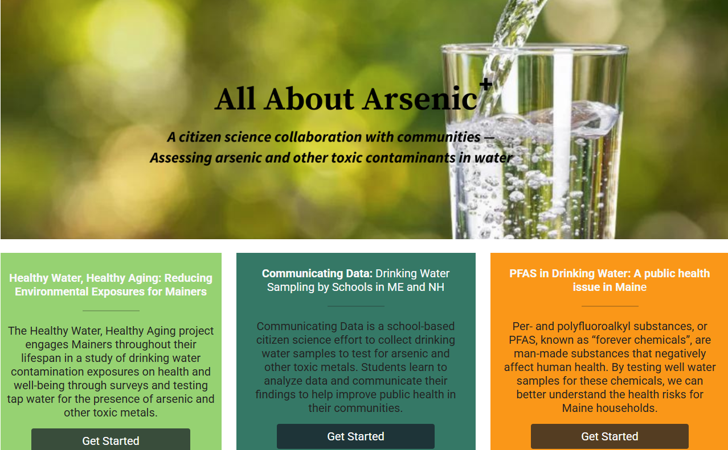
Notes:
This SEPA project website has resources for teachers involved in the project and information for people who have submitted samples through the project.

Slide 6

~2.1 million Americans live in areas with high levels of arsenic
USGS
Notes:
Resources on our project website include information that teachers can use to teach about arsenic in drinking water. Like this probability map that s based on bedrock.

Slide 7

Arsenic is found in bedrock in Maine and New Hampshire
Ellsworth Schist
Credit: Sarah Hall, College of the Atlantic
Notes:
People living in rural areas drill their wells into bedrock containing arsenic

Slide 8
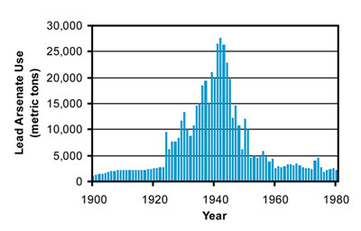
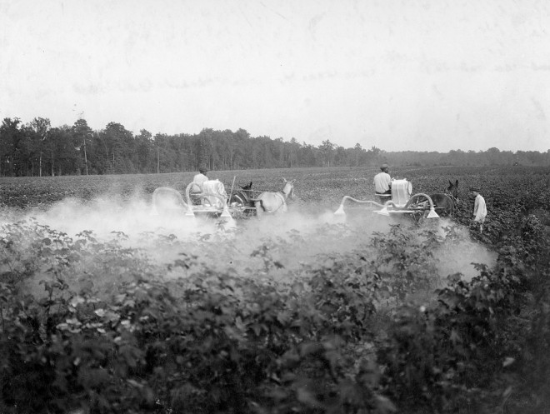

Use of lead arsenate as a pesticide in the past could contribute to arsenic in drinking water today
Notes:
It is possible that arsenic leaches into well water from soils contaminated with arsenical pesticides. Even though these pesticides are no longer used, the arsenic could still be in the soil.

Slide 9
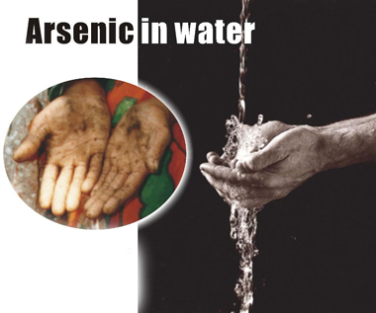


Arsenic is found in water and food; it is odorless, tasteless, and colorless
EPA established a goal of zero arsenic in drinking water and adopted a limit of 10 ppb. NH has lowered the standard to 5 ppb.
Images EHP and Google
Notes:
Some states have lowered the allowable limit to 5ppb (NH and NJ) and Maine is considering this too
~500 million people are exposed to arsenic in drinking water worldwide.
The WHO and the EPA standard for drinking water is 10 ppb
~3 billion people are exposed to arsenic in rice and rice products

Slide 10
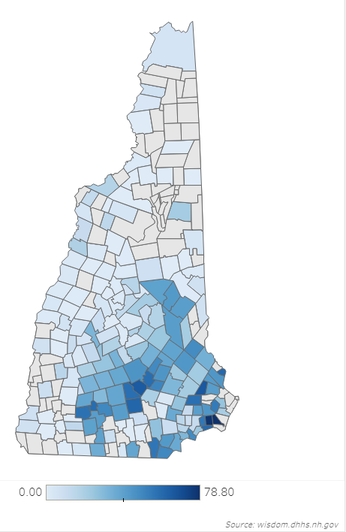
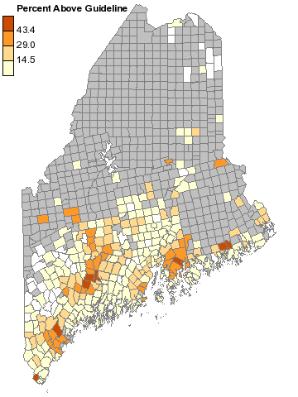
Wells in ME and NH
Percent of Wells that Exceed State Guideline
for Arsenic of 10 µg/L (ME) or 5 µg/L (NH) by Town
Wells | Maine | New Hampshire
Reliance on private wells | 56% | 46%
Wells with elevated arsenic | 10% | 20%
Wells that have never been tested for As | 42% | unknown
New Hampshire
Maine
Maine CDC, Dartmouth Toxic Metals Superfund Research Program, USGS, Maine Tracking Network, New Hampshire DHHS Data Portal
Notes:
Arsenic is a problem in Maine and New Hampshire because there are so many people deriving their drinking water from private wells. The Safe Drinking Water Act does not regulate private wells, so homeowners have to know to test their wells!

Slide 11
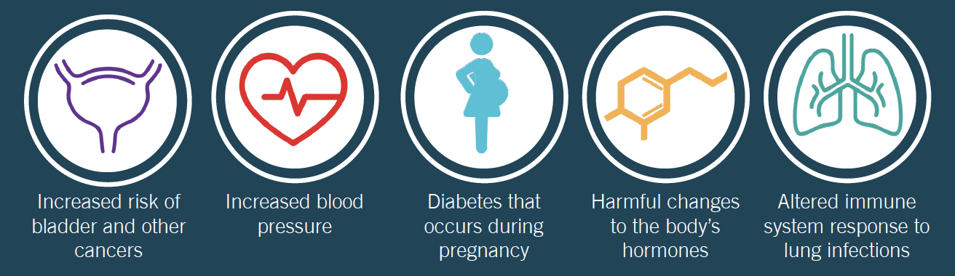
Arsenic Health Concerns
Health Effects of Arsenic
Credit: Dartmouth Superfund Research Program

Slide 12

Arsenic: 5–10-point decrease in IQ
“A cross-sectional study of well water arsenic and child IQ in Maine schoolchildren”
Possibility that drinking water with >5 ppb arsenic poses a threat to child development.
Wasserman, G.A., Liu, X., LoIacono, N.J. et al. A cross-sectional study of well water arsenic and child IQ in Maine schoolchildren. Environ Health 13, 23 (2014). https://doi.org/10.1186/1476-069X-13-23
Notes:
Conclusion: “The magnitude of the association between drinking water arsenic and child IQ raises the possibility that levels of arsenic in drinking water greater than or equal to 5 ppb, levels not uncommon in the United States, pose a threat to child development."

Slide 13
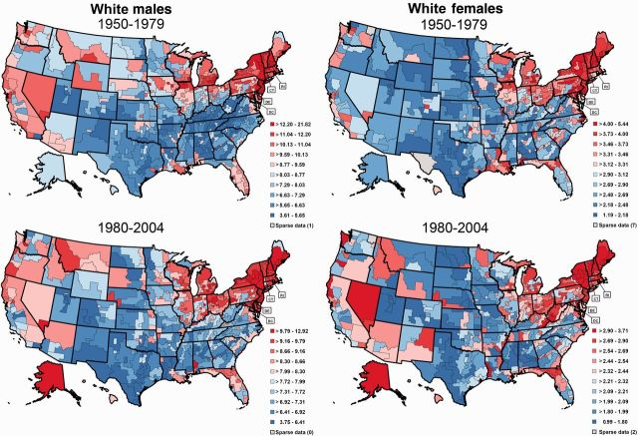
Cancer from Arsenic Exposure
“Elevated Bladder Cancer in Northern New England: The Role of Drinking Water and Arsenic”
Increasing cumulative exposure to arsenic in well water was associated with an increasing risk of bladder cancer.
Baris D … Silverman DT, et al. Elevated Bladder Cancer in Northern New England: The Role of Drinking Water and Arsenic. Journal of the National Cancer Institute. May 2, 2016. JNCI. DOI: DJW099

Slide 14
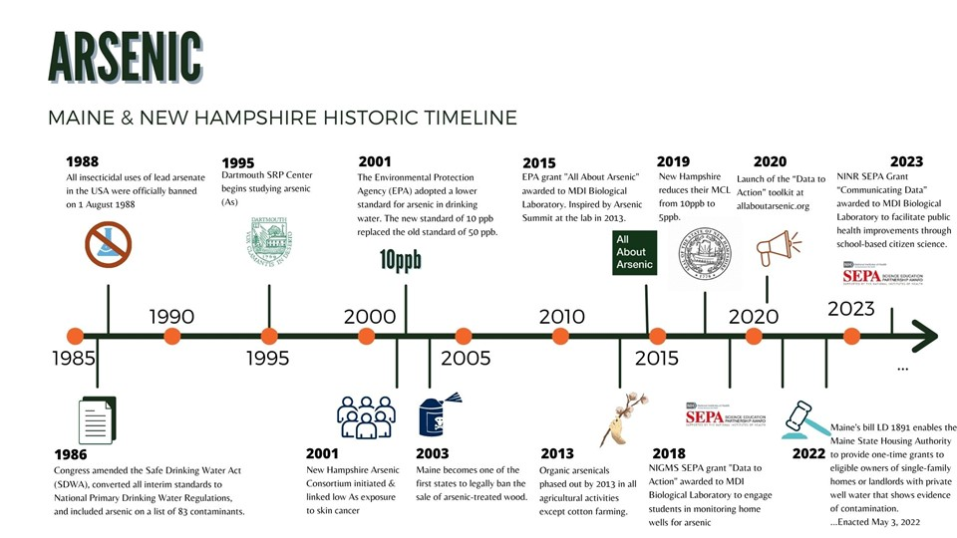
Updated From: Farrell et al. Journal of STEM Outreach 4, no. 2 (July 19, 2021): 1–14.
Notes:
This timeline shows where our project fits into the history of drinking water legislation and understanding of health impacts of arsenic

Slide 15
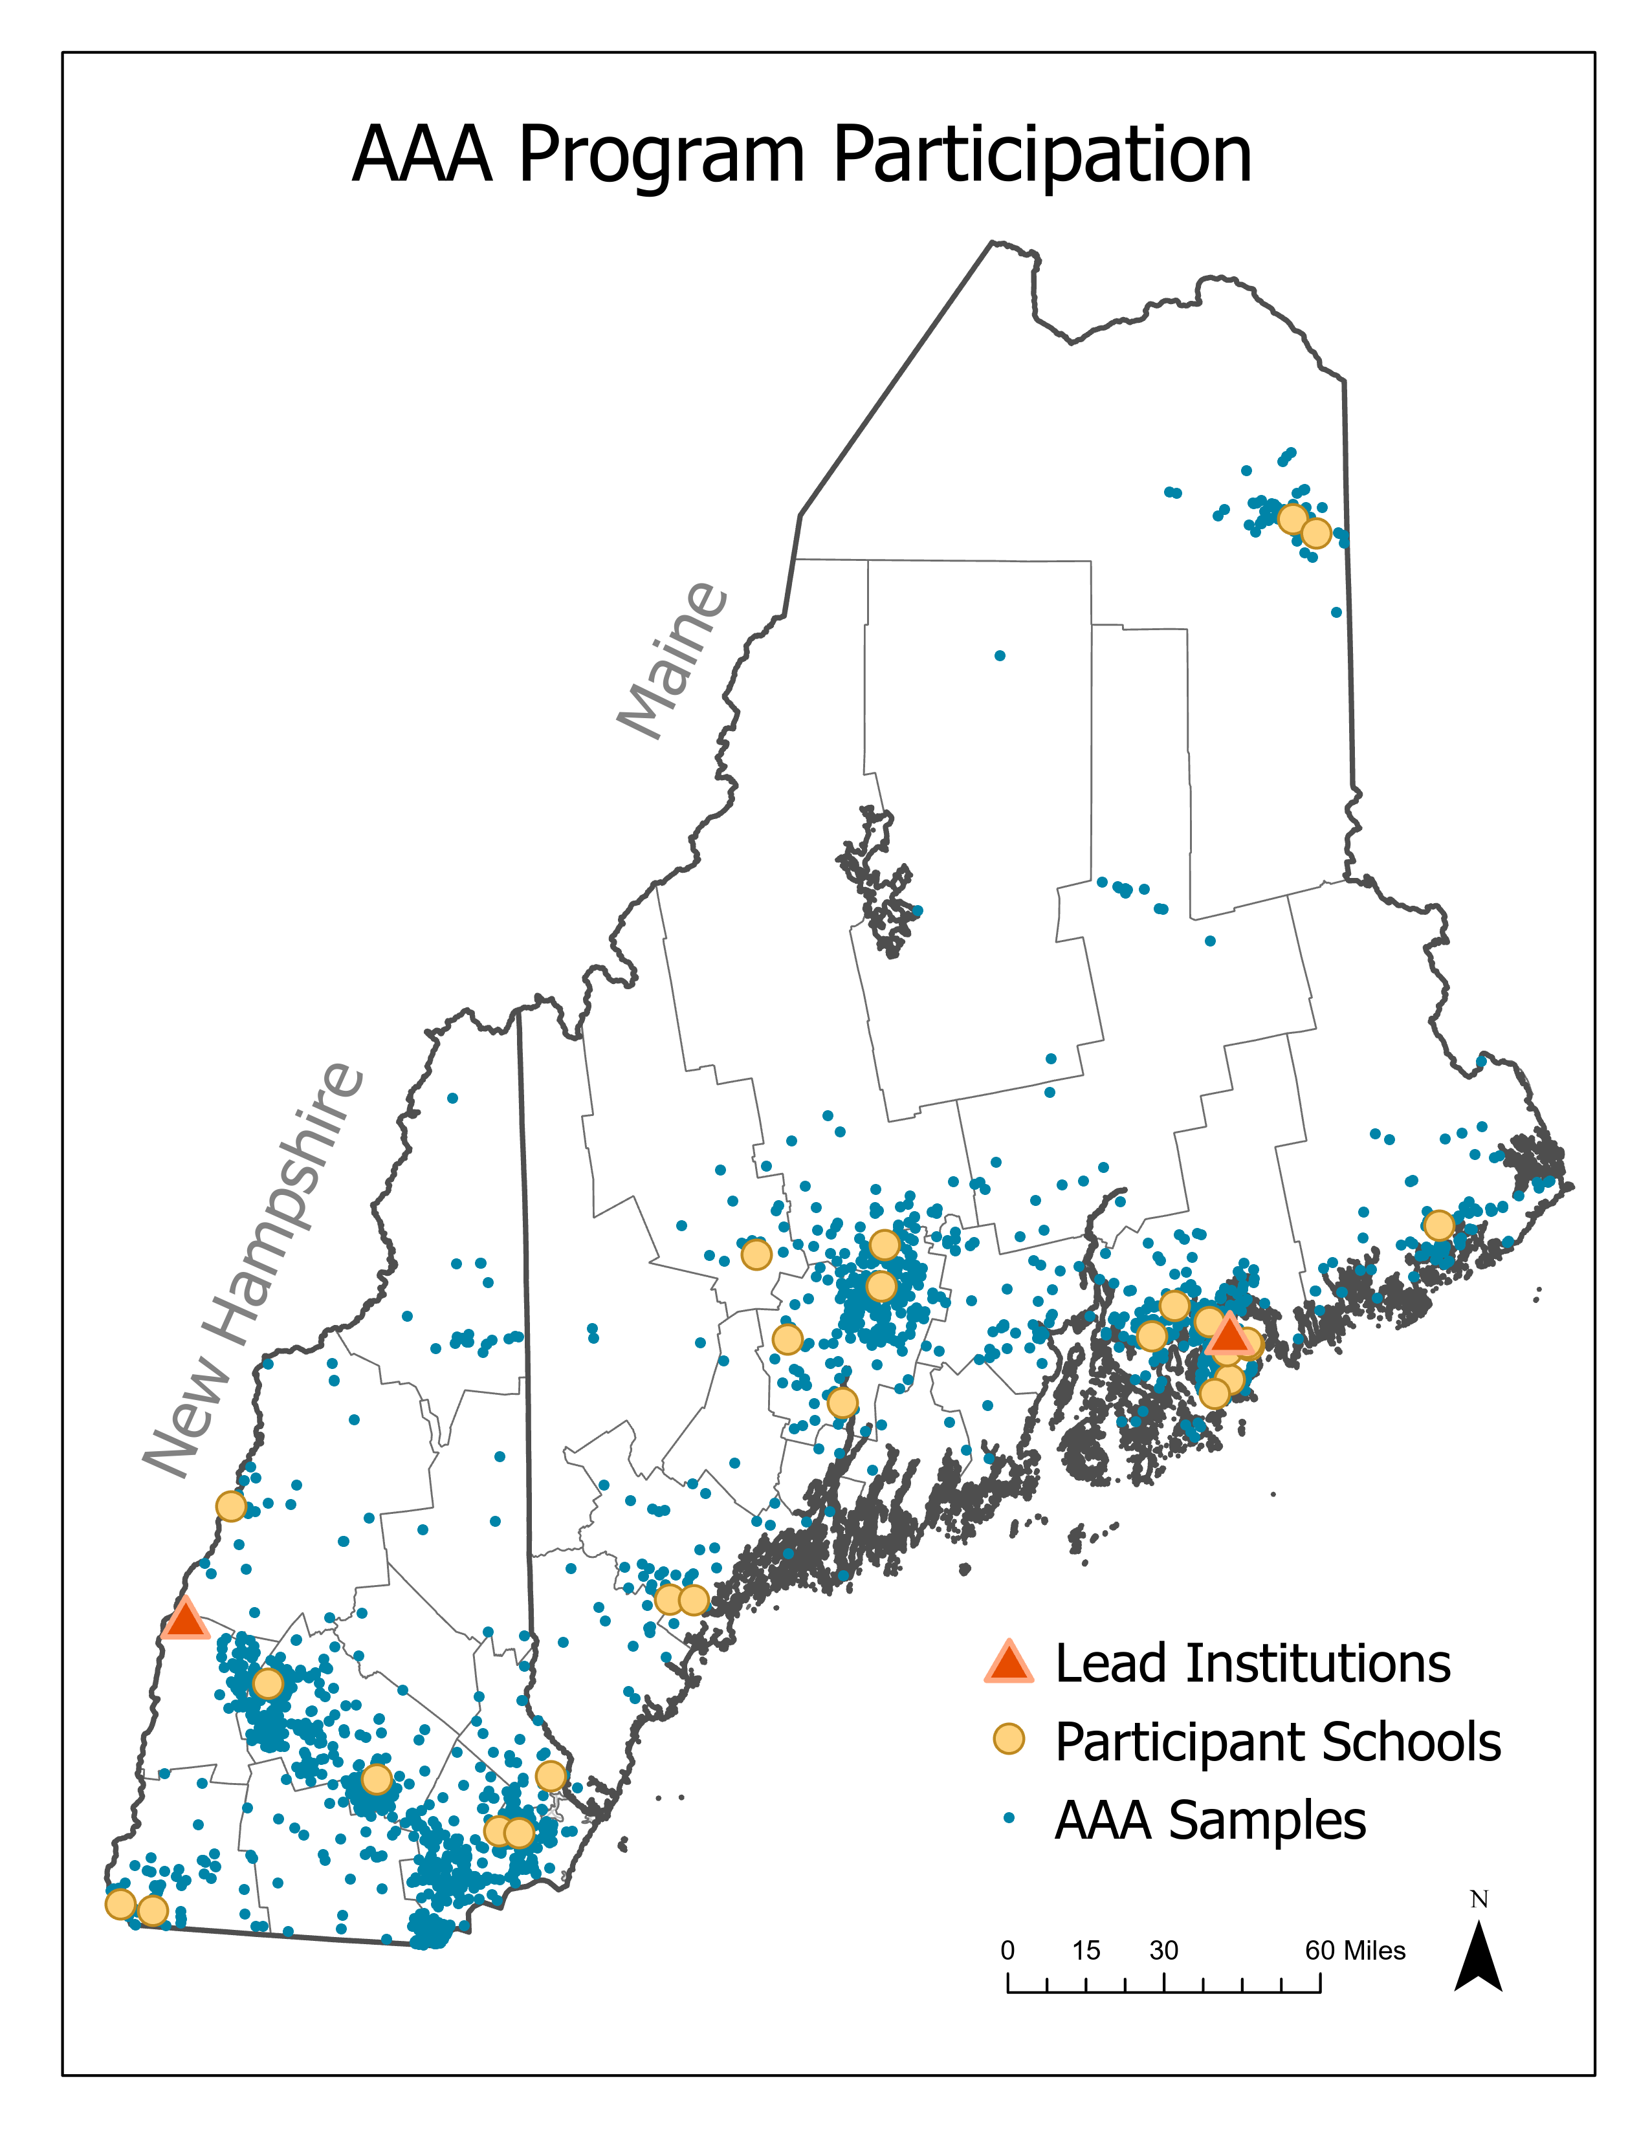
Reach and Outcomes 2016-2025
2016-2023
>32 schools
New additions for the 2025-2026 school year:
NH DES Schools
New SEPA Schools/Teachers
Returning SEPA Teachers/Schools
Kingswood Regional High School
Bedford High School
Nute Middle High School
Green Mountain Conservation Group
Coe-Brown Northwood Academy
4855 samples
>5000 students
Fall Mountain Regional High School
Pinkerton Academy
Bow High School
Pelham High School

Slide 16
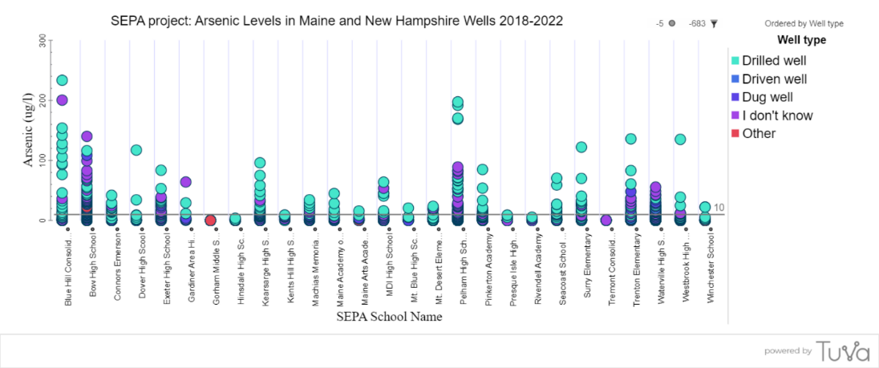
For our SEPA project, we collaborate with Tuva. Student data can be analyzed on a special platform created for our project at arsenicdata.tuvalabs.com
Notes:
In our project, students use Tuva Data Literacy software to look at variation in arsenic levels in water samples. This graph was made using data at arsenicdata.tuvalabs.com. Schools in different communities have different results. Many wells do exceed the Maximum Contaminant Level of 10 ppb in ME and 5 ppb in NH.

Slide 17
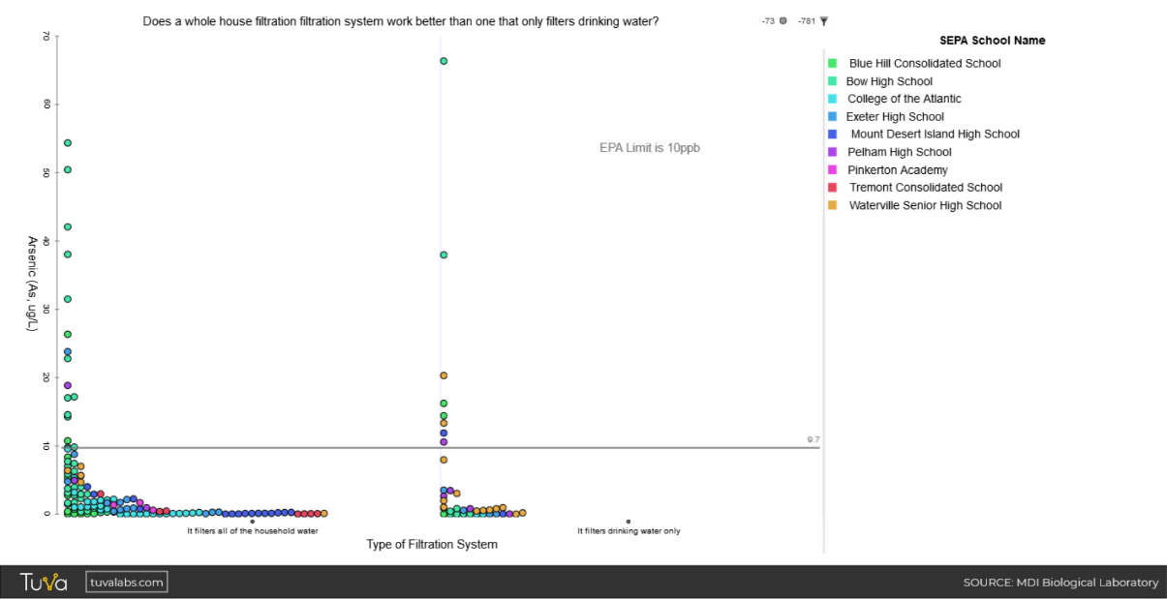
What students are discovering about filtered samples
Blue Hill Consolidated School
Bow High School
College of the Atlantic
Exeter High School
Mount Desert Island High School
Pelham High School
Pinkerton Academy
Tremont Consolidated School
Waterville Senior High School
Arsenic µg/L or ppb
EPA Limit: 10 ppb
Filters all of the household water
Filters drinking water only
Notes:
Filtration systems in many homes in our study may not be working or may be the wrong type for filtering out arsenic

Slide 18
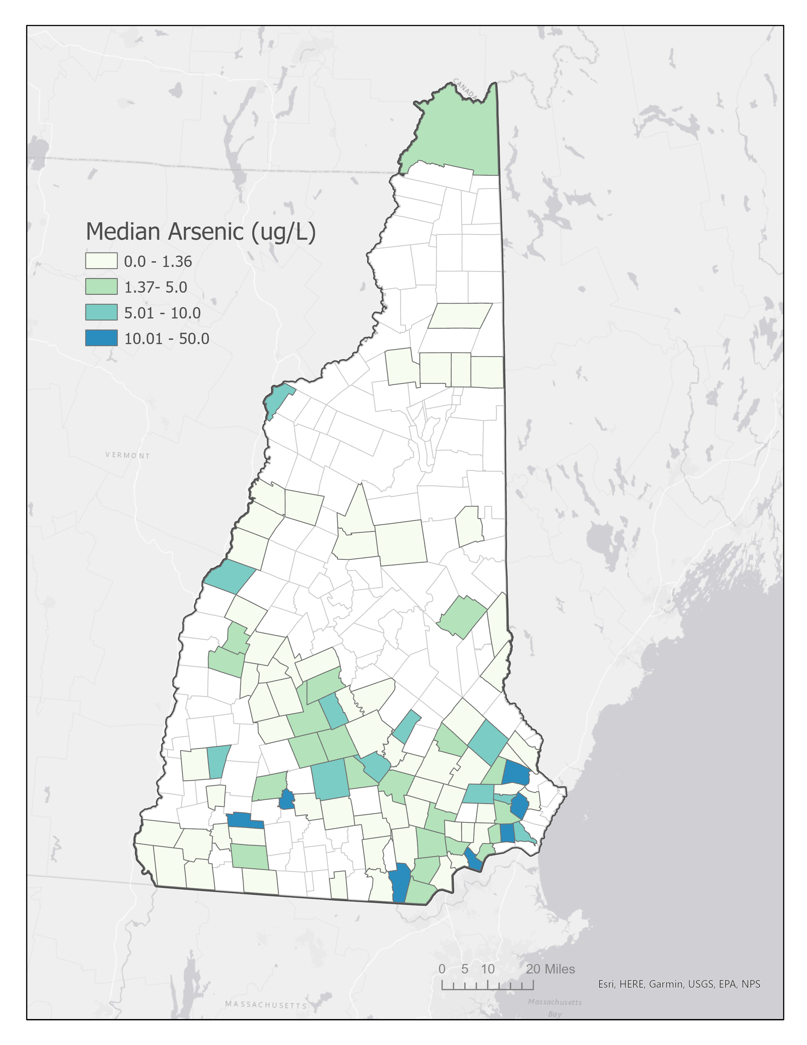
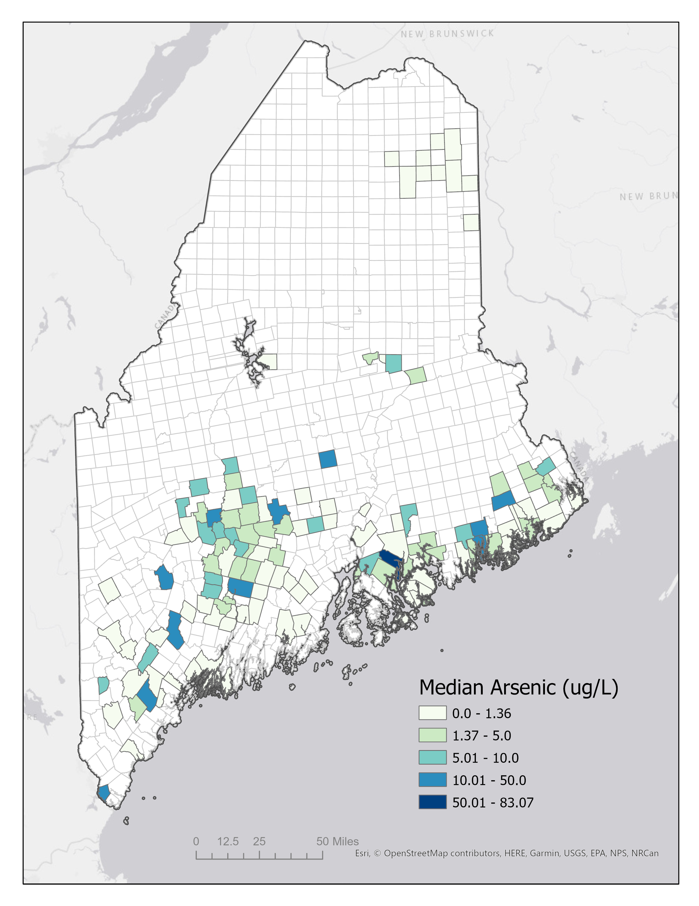
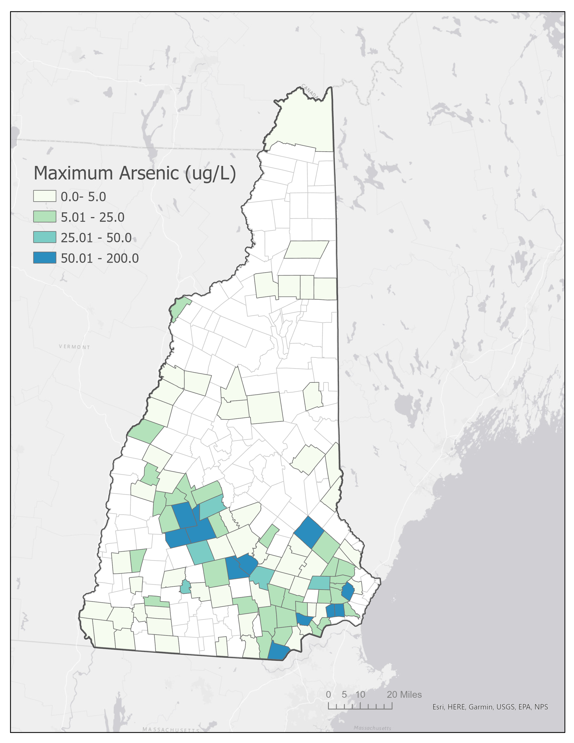
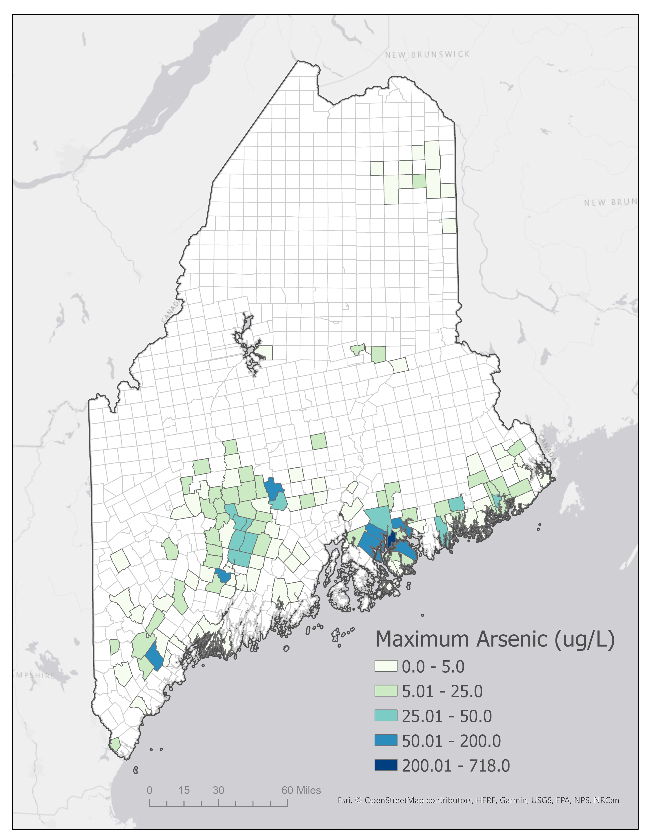
Arsenic levels in SEPA well water dataset
Median As in New Hampshire and Maine Maximum As in New Hampshire and Maine

Slide 19
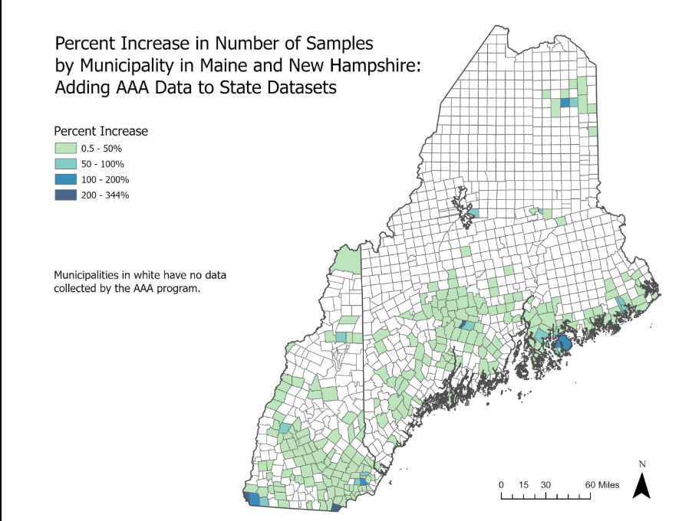
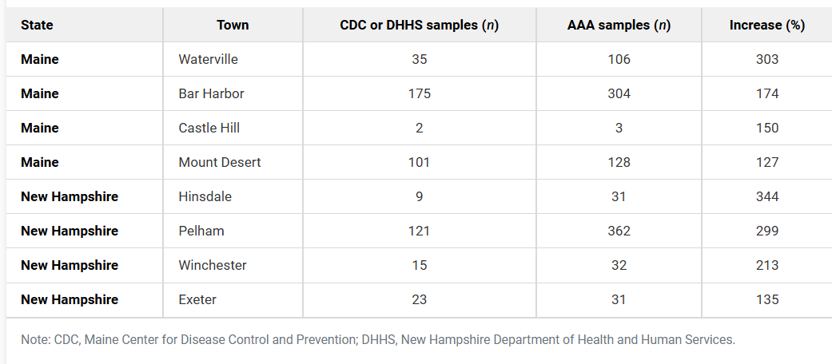
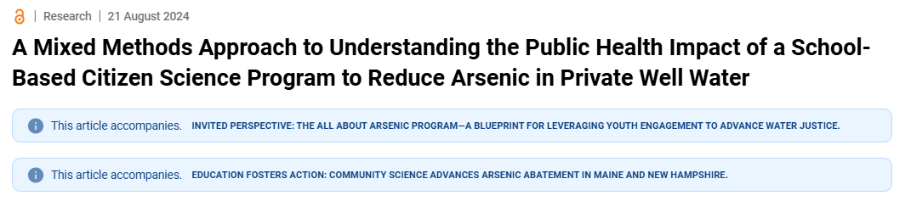

Slide 20
Specific Aims for SEPA
Specific Aim #1. Support a science classroom culture of effective scientific communication.
Objectives
Develop science communication modules for teachers
Engage teachers in planning science communication integration into the curriculum
Provide access to additional resources for science communication
Outcomes
Teachers learn how citizen science can provide the opportunity for students to tell data-supported stories
Teachers and students gain the capability to effectively communicate their drinking water data and what they have learned about drinking water contamination issues with the goal of educating their communities, encouraging remediation actions, and improving public health.

Slide 21
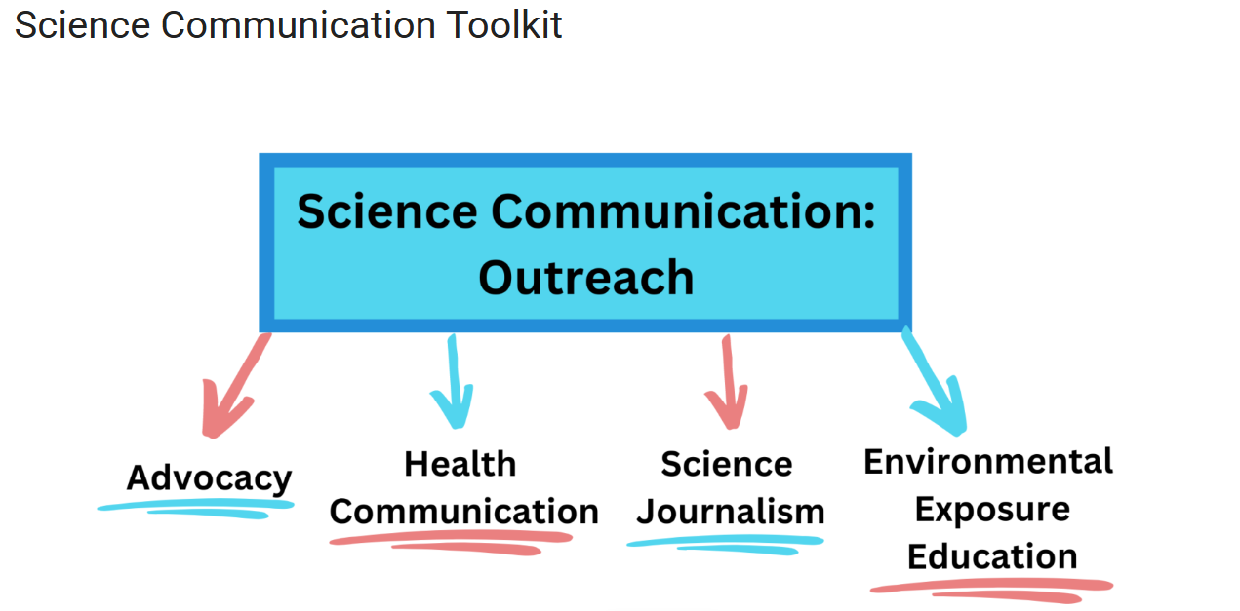

Slide 22

Civic Action Toolkit on AllAboutArsenic.org
Notes:
Students use our Civic Action Toolkit to learn about Advocacy and how to take action on their data.

Slide 23
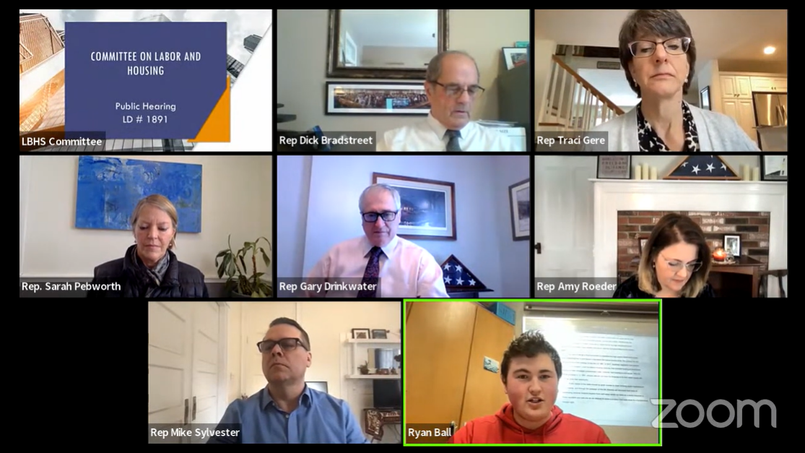
Student presenting testimony in support of legislation to provide grants to eligible owners of single-family households or landlords with contaminated private well water.

Slide 24
Specific Aim #2. Provide an opportunity for students from both rural and urban communities to sample home drinking water for toxic contaminants and contribute to a novel student-developed dataset to achieve positive public health outcomes.
Objectives
Teachers implement a drinking water curriculum that is relevant to their students
Students will develop hypotheses, collect well water from their tap for analysis of heavy metals and distribute project information to their communities
Parents/community members will receive data reports with recommendations for contaminant removal.
Outcomes
Having engaged in the actual work of scientists who address public health issues, students become knowledgeable and experienced in the practice of science.
By practicing scientific skills, students increase their researcher identity, and may be inspired to pursue science or health-related careers.
Families have knowledge to make informed decisions about their drinking water

Slide 25
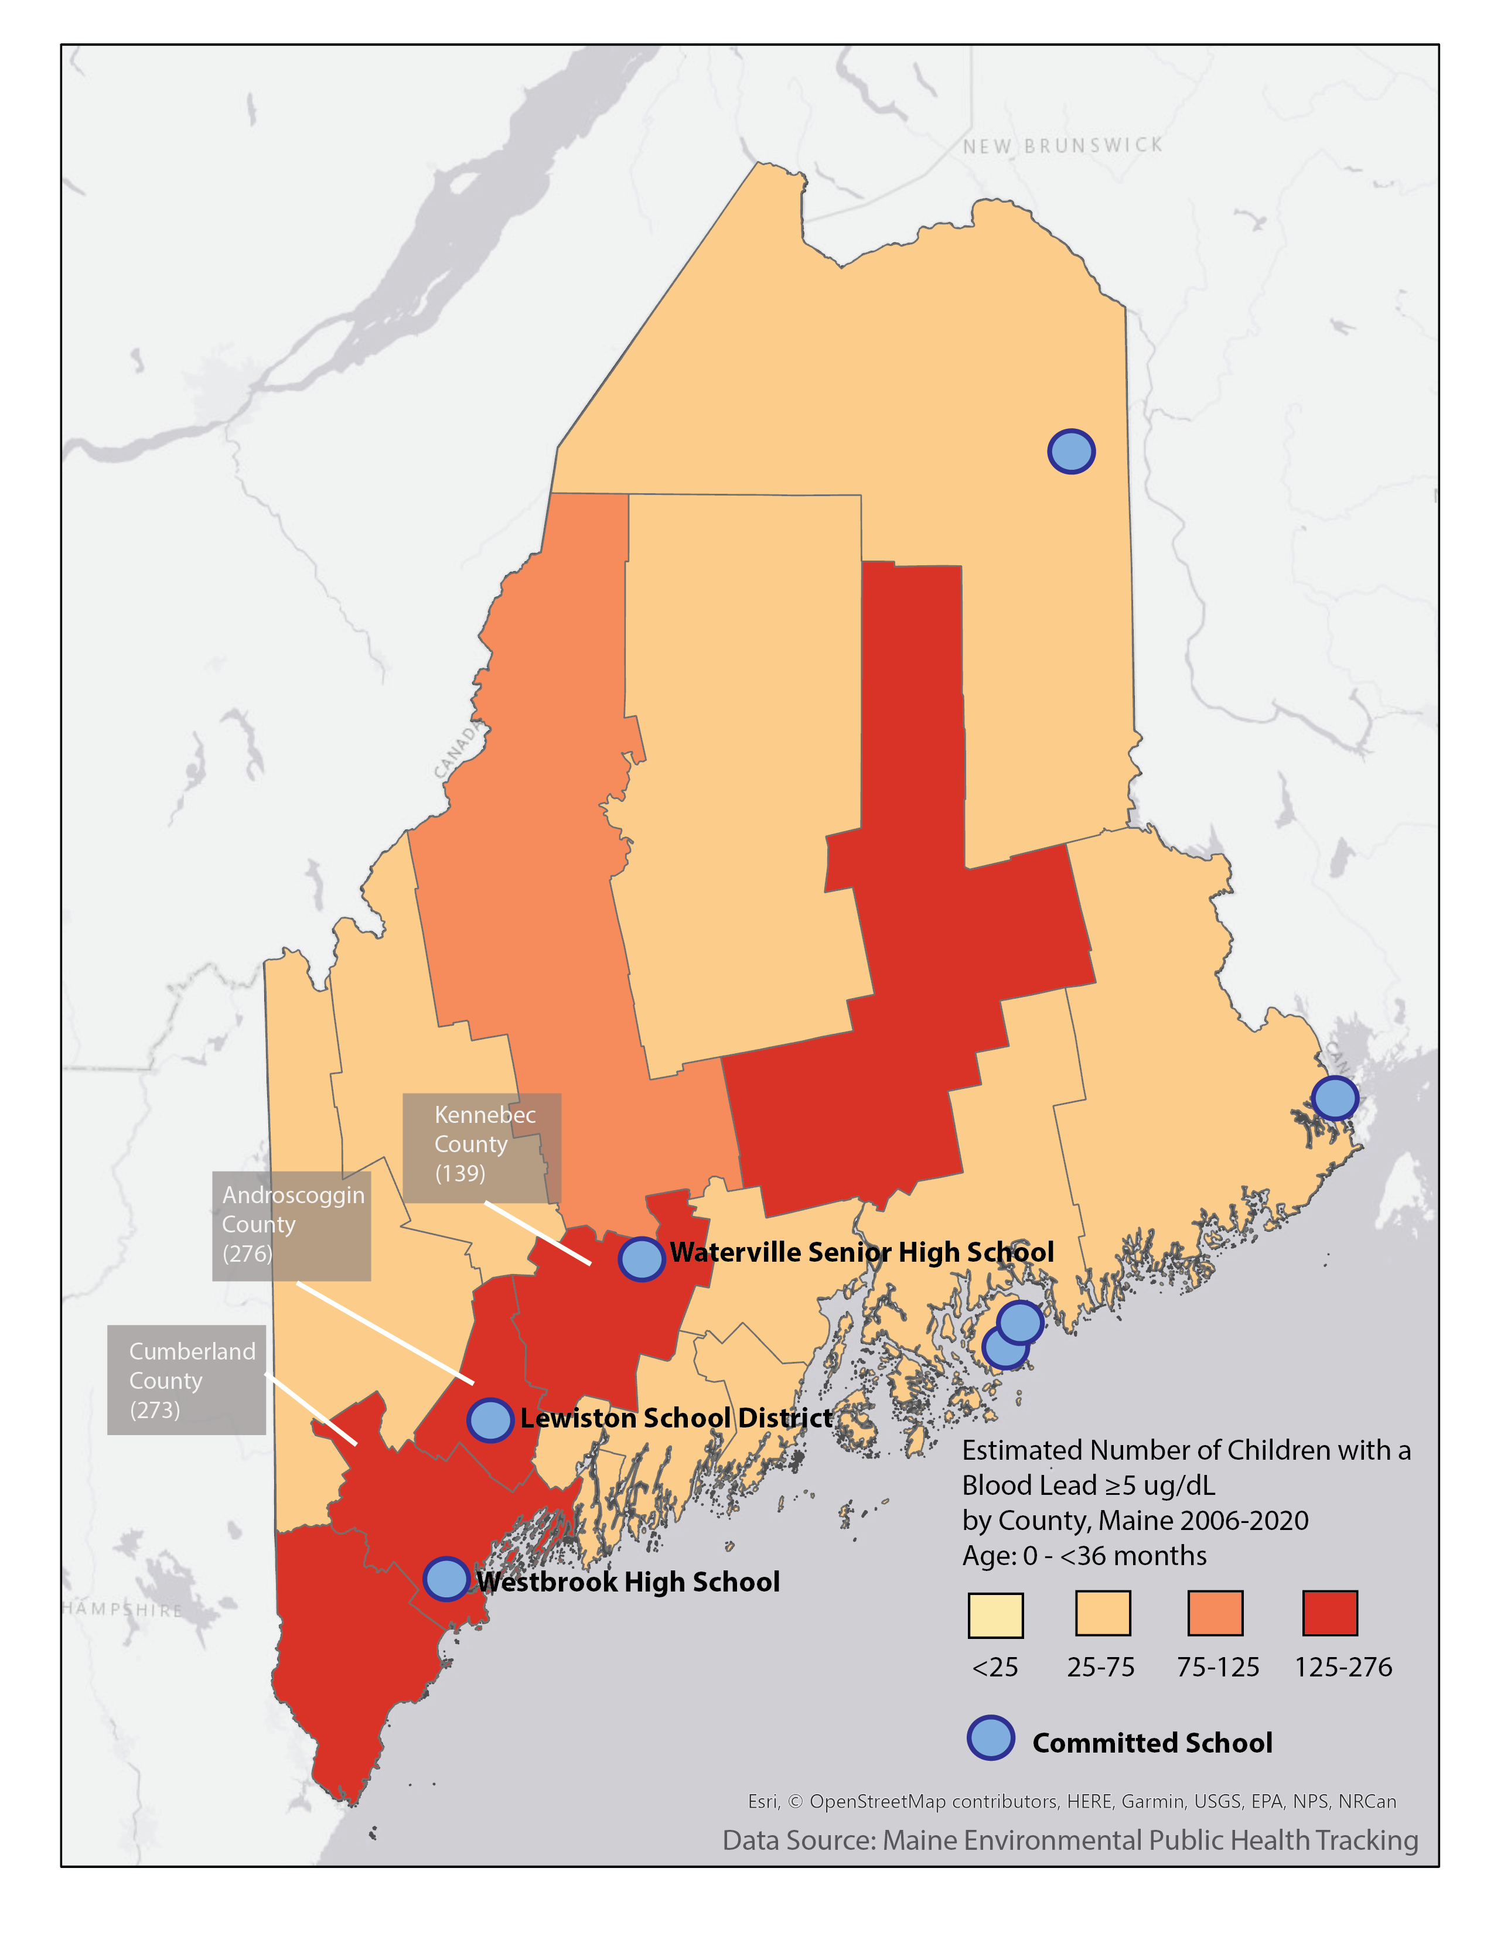
For SEPA Schools:
Why sample public drinking water; isn’t it regulated?
Number of children with elevated lead in blood by county in Maine-how much is related to exposure to drinking water?

Slide 26
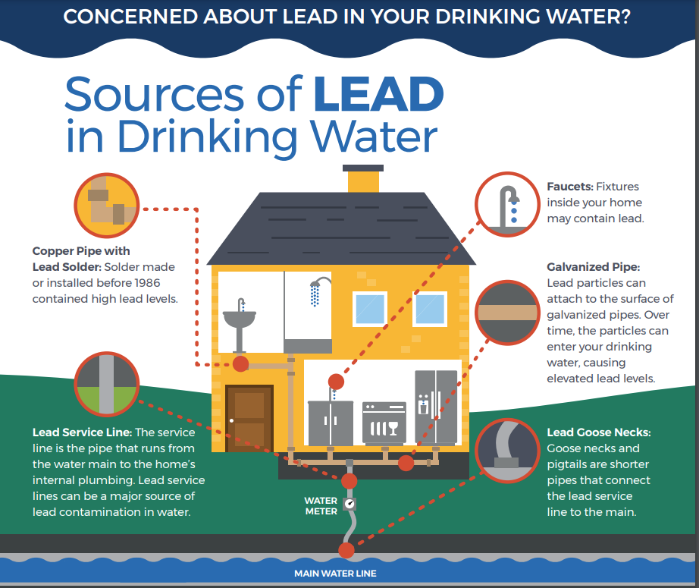
https://www.epa.gov/sites/default/files/2017-08/documents/epa_lead_in_drinking_water_final_8.21.17.pdf
Notes:
Some older homes have lead pipes or lead solder holding copper pipes together. This could contaminate drinking water. Even houses receiving public water could have lead.

Slide 27
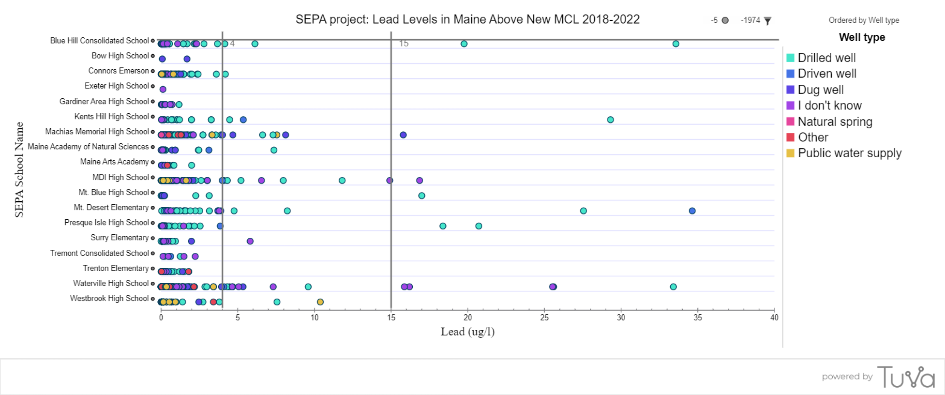
In our first SEPA project, students discovered issues often associated with public water systems (think Flint, Michigan!)
Notes:
Students have generated a unique dataset on lead in drinking water. As you can see, there are many households with lead above the EPA limit of 15 ppb.

Slide 28
Specific Aim #3. Promote intergenerational learning and interest in STEM careers.
Objectives
Create a take-home kit, activity, or “conversation prompt” aimed at increasing parent-child interaction around drinking water issues that build on student knowledge and experience at school.
Outcomes
Parents may be more likely to take action to address drinking water issues in their home with increased interaction with their child on the topic of drinking water quality.

Slide 29


Slide 30

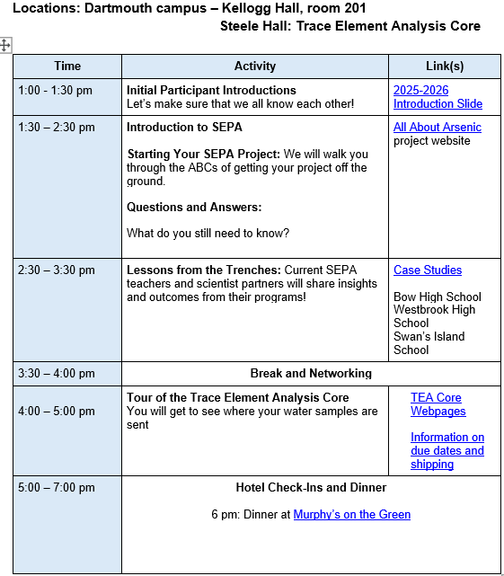
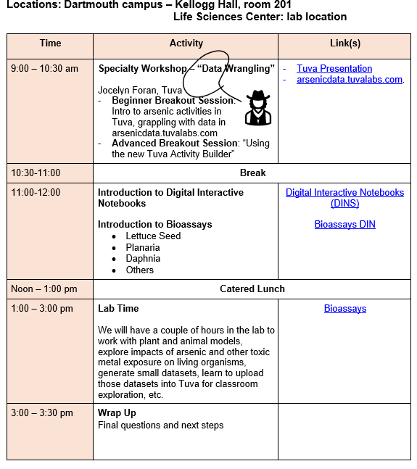
Moodle Activities and Teacher Training Workshop

Slide 31
SEPA Team
Data Literacy Consultant
Leadership
Jocelyn Foran, Science Education Specialist at Tuva
Jane Disney, Ph.D., MDI Biological Laboratory
Brian Jackson, Ph.D., Dartmouth College
Evaluators
Karen Bieluch, Ph.D., Dartmouth College
Bill Zoellick, Schoodic Institute
Christine Smith, MDI Biological Laboratory
Coordinators
Systems Developer-Anecdata
Ramsey Steiner: Trace Element Analysis Core
Caitlin Oliver-Olsen MDI Biological Laboratory
Cait Bailey, MDI Biological Laboratory

